Slide 1
Evaluating the Fit of IRT Models: Diagnostics
Derek Briggs
EDUC 8720

Slide 2
My Acronym for Fit Diagnostics: DDMIPLiP (“DeeDeeMipLip”)
Remember
Descriptives
Dimensionality
Model Comparisons and Global Fit
Item fit
Person fit
Local independence
Parameter Invariance

Slide 3
Context: CDE Math Data Set

Slide 4
Data from a standardized math test administered by the California Department of Education (CDE).
31 MC items.
Calibration Sample of 1,500 students.
Cross-validation sample of 500 students.
Observed Scores: MEAN = 17.8, SD = 6

Slide 5
Descriptives

Slide 6
Descriptives
tot <- apply(d,1,sum)
table(tot) # will need to watch for perfect/0 scores
hist(tot, breaks=seq(-0.5,31.5,1), las=1, col="grey")
itemstats(d)

Slide 7
Dimensionality

Slide 8
Dimensionality: Parallel Analysis
Basic idea for data set with K items and N persons:
Generate random, uncorrelated data for K variables across N persons (i.e., data with no common factors).
Calculate the eigenvalues of the correlation matrix.
Repeat 1-2 many times.
Look at the average value of the largest eigenvalue, average of second largest, etc.
Compare averages in (4) to eigenvalues in your data.
Keep # of factors for which observed eigenvalues are greater than those in (5).
Could use 95th percentile instead of mean in (4).
Debate about whether to use Pearson correlations, tetrachoric, PCA vs factor analysis.

Slide 9
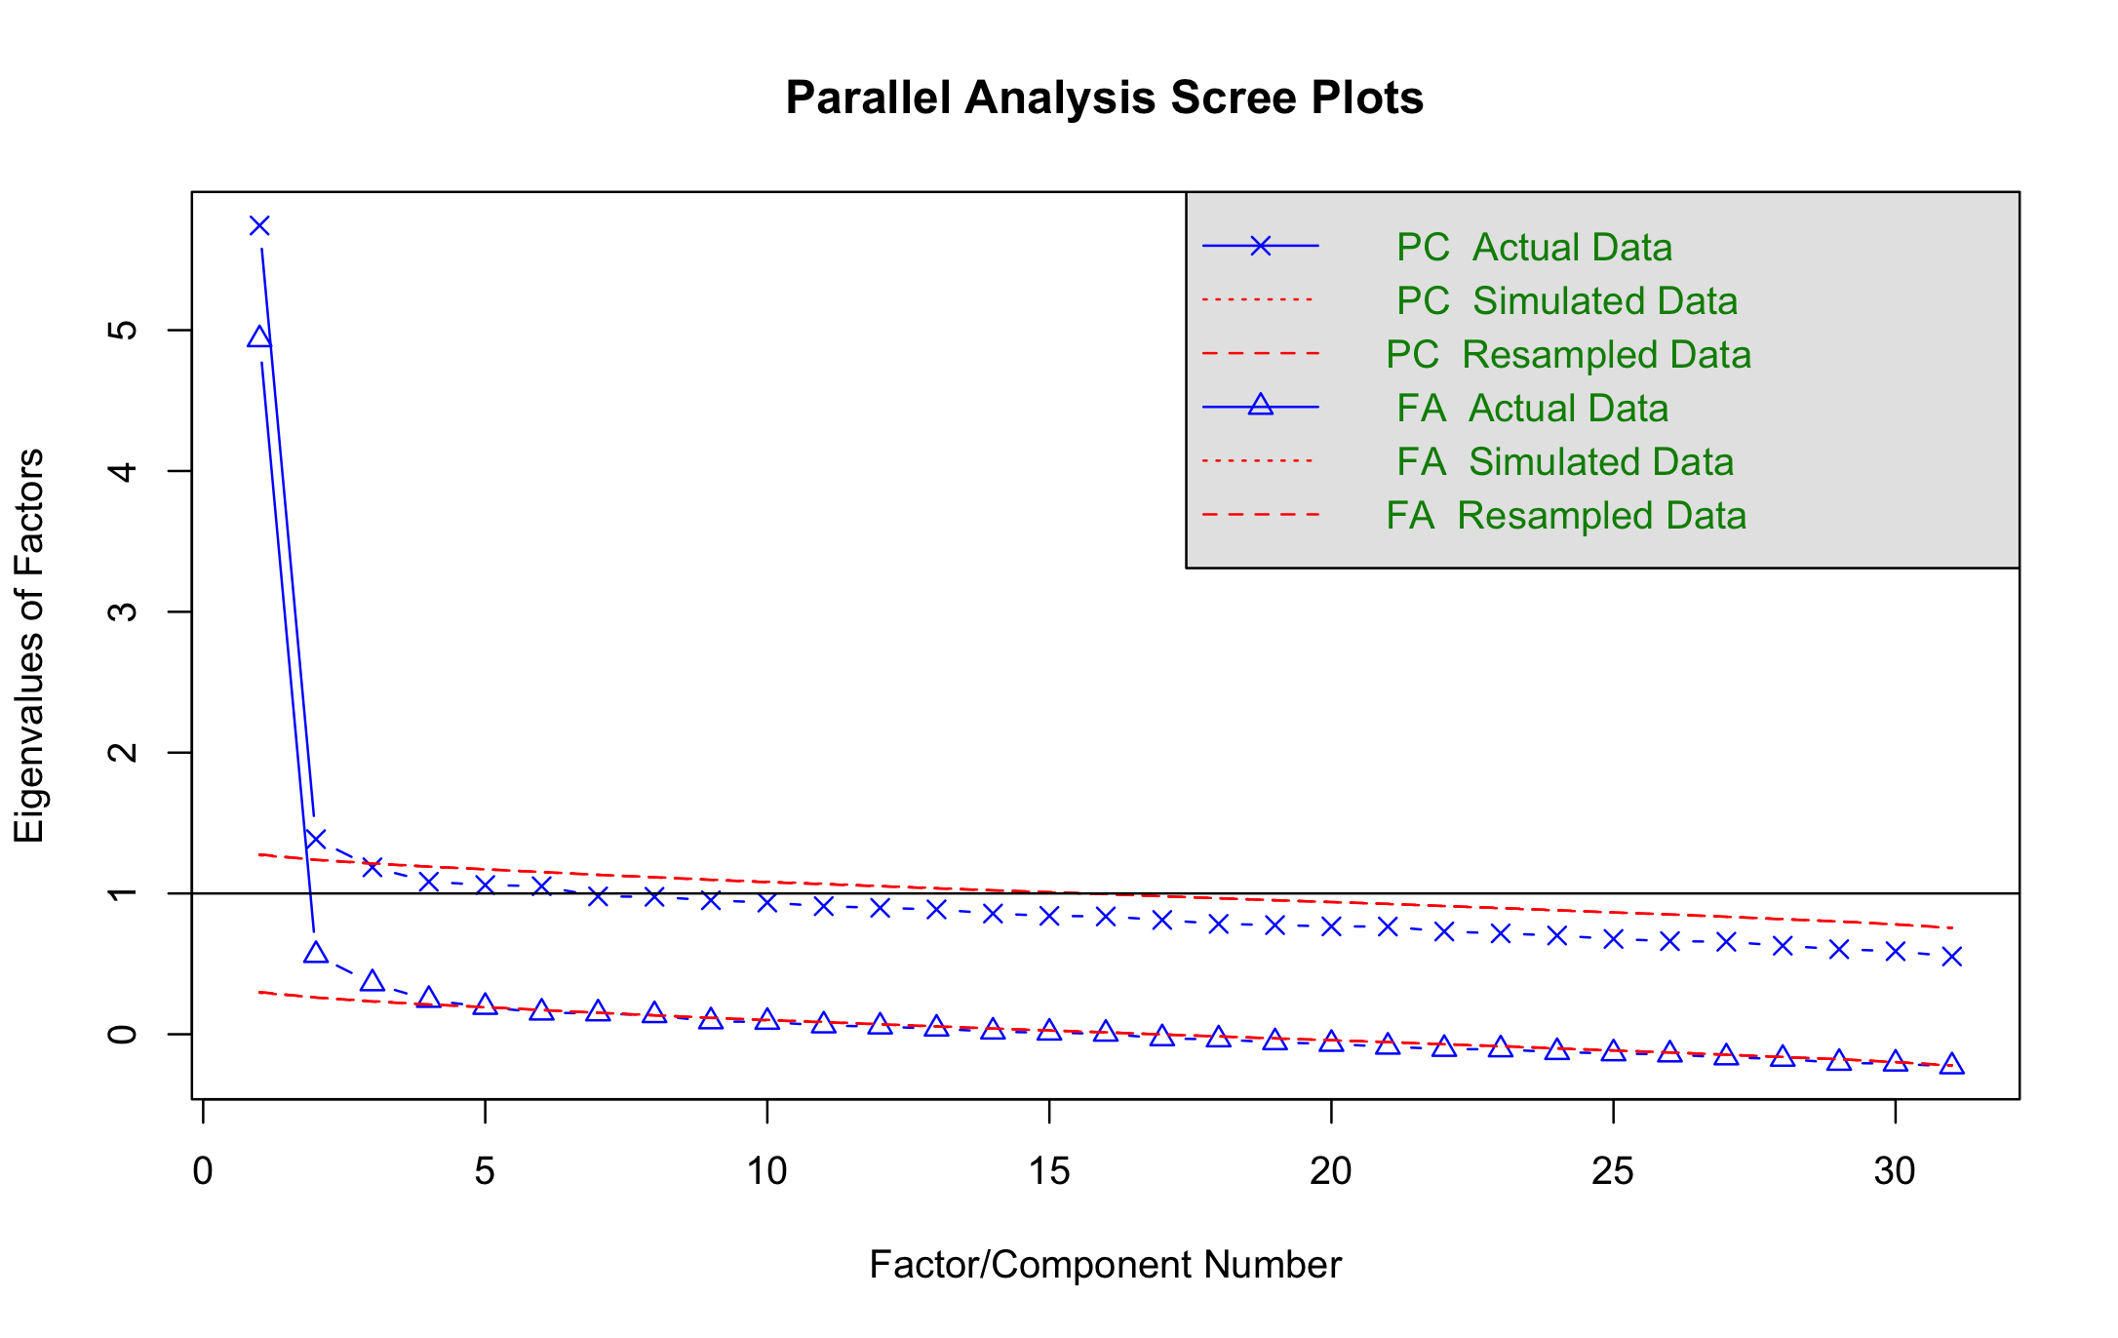
Dimensionality: Parallel Analysis Scree Plot
pa<-fa.parallel(cde,fm="pa", fa="both",main = "Parallel Analysis Scree Plots", n.iter=50,SMC=TRUE,ylabel="Eigenvalues of Factors",show.legend=TRUE)
We see some evidence of a “statistically significant” second dimension.

Slide 10
Criteria for Unidimensionality in IRT Models for Large-Scale Assessment?
Lord (1980) stated that if the ratio of the first to the second eigenvalue is large and the second eigenvalue is close to other eigenvalues, the test is unidimensional. Divgi (1980) expanded Lord’s idea and created an index by considering the pattern of the first three factor components (eigenvalues). The Divgi Index examines the ratio of the difference of the first and second eigenvalues over the difference of the second and third eigenvalues. A large ratio indicates a greater difference between the first and second eigenvalues, thus, creating a unidimensional tendency. A cut value of 3 is chosen for the index so that values greater than 3 are considered unidimensional.
--From the large-scale assessment technical report of state of Illinois, 2008

Slide 11
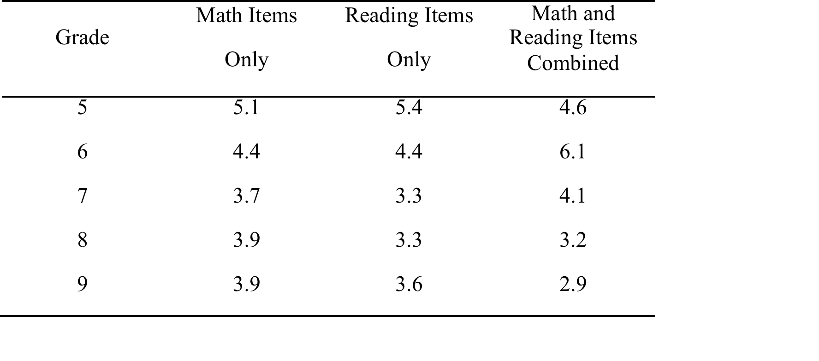
Upshot of this Criterion…
Pretty much all educational tests typically look ”essentially” unidimensional
Even if we combine math and reading items together! Table below shows results when I did this using Colorado’s state test data
Divgi Ratio
So be careful. There is difference between statistical dimensionality and theoretical dimensionality.

Slide 12
Model Comparisons and Global Fit

Slide 13
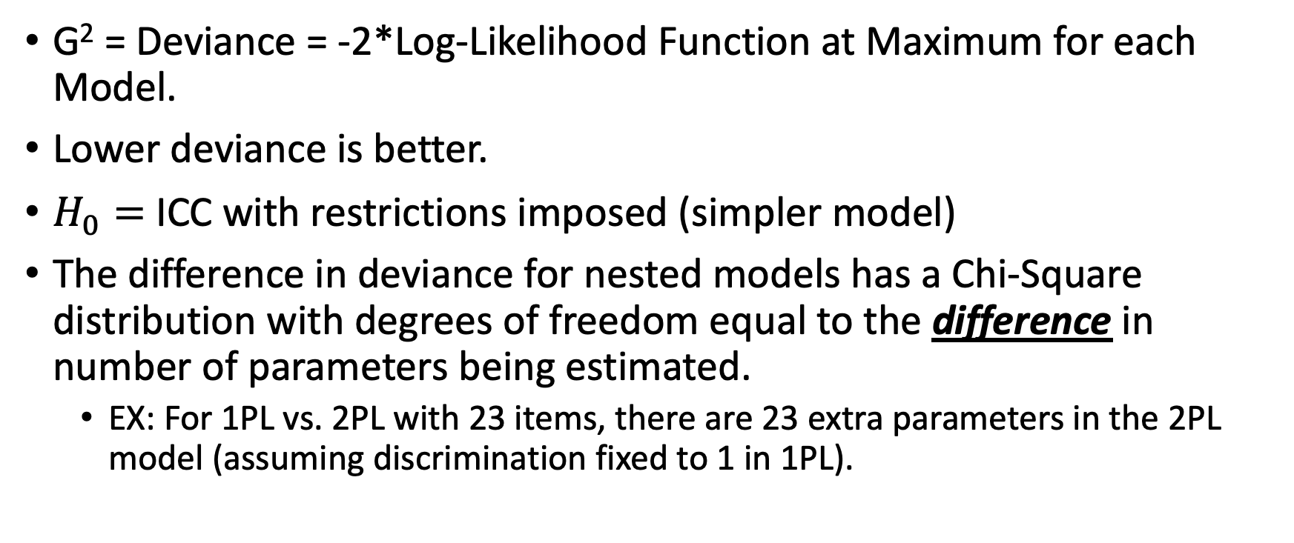
Model Fit Comparisons
G² = Deviance = -2*Log-Likelihood Function at Maximum for each Model.
Lower deviance is better.
$H_{0}=$ ICC with restrictions imposed (simpler model)
The difference in deviance for nested models has a Chi-Square distribution with degrees of freedom equal to the difference in number of parameters being estimated.
EX: For 1PL vs. 2PL with 23 items, there are 23 extra parameters in the 2PL model (assuming discrimination fixed to 1 in 1PL).

Slide 14
Comparing fit of 1PL, 2PL, 3PL
# fit 1, 2, 3pl models
mod1 <- mirt(d, 1, itemtype = "Rasch”, SE = TRUE)
mod2 <- mirt(d, 1, itemtype = "2PL”, SE = TRUE)
mod3 <- mirt(d, 1, itemtype= "3PL", SE = TRUE)
# Compare overall fit of 1PL to 2PL
anova(mod1,mod2)
# Compare overall fit of 2PL to 3PL
anova(mod2,mod3)

Slide 15
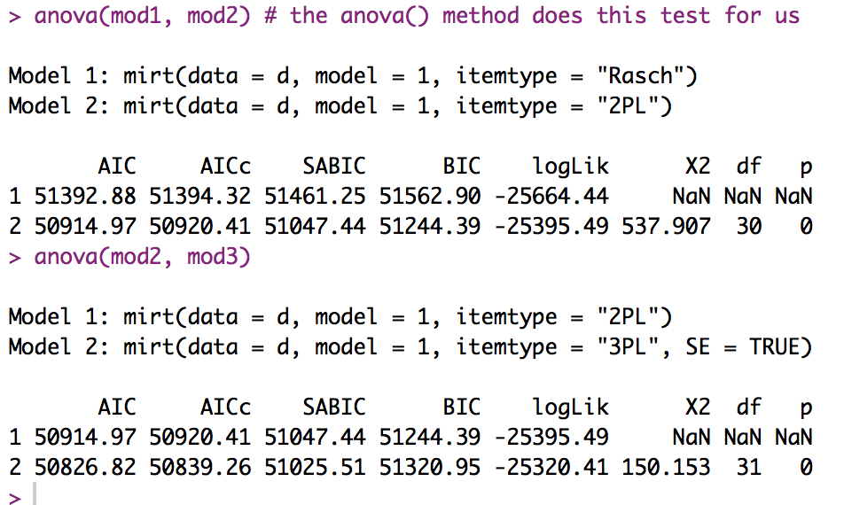
Global Tests of Fit: Results
Also reports AIC and BIC values. These can only be interpreted as relative fit. Similar models fit to same data with lower values fit better.
Not too surprising, will often be the case that 3PL fits better globally than 2PL and 2PL fits better than 1PL.

Slide 16
An aside for Students who have taken structural equation modeling…

Slide 17
mirt can also produce SEM Fit Statistics (results from applying the “M2” fcn)
Model | M2 | df | p | RMSEA | RMSEA_5 | RMSEA_95 | SRMSR | TLI | CFI
1PL | 1113.1 | 434 | 0 | 0.032 | 0.030 | 0.035 | 0.055 | 0.961 | 0.961
2PL | 708.1 | 405 | 0 | 0.022 | 0.020 | 0.025 | 0.029 | 0.981 | 0.983
3PL | 575.2 | 375 | 0 | 0.019 | 0.016 | 0.022 | 0.026 | 0.987 | 0.989
Note: All three models seem ok with respect to approximate fit stats like RMSEA, SRMSR, TLI, CFI
M2: Maydeu-Olivares, A. & Joe, H. (2006). Limited information goodness-of-fit testing in multidimensional contingency tables. Psychometrika, 71, 713-732.

Slide 18
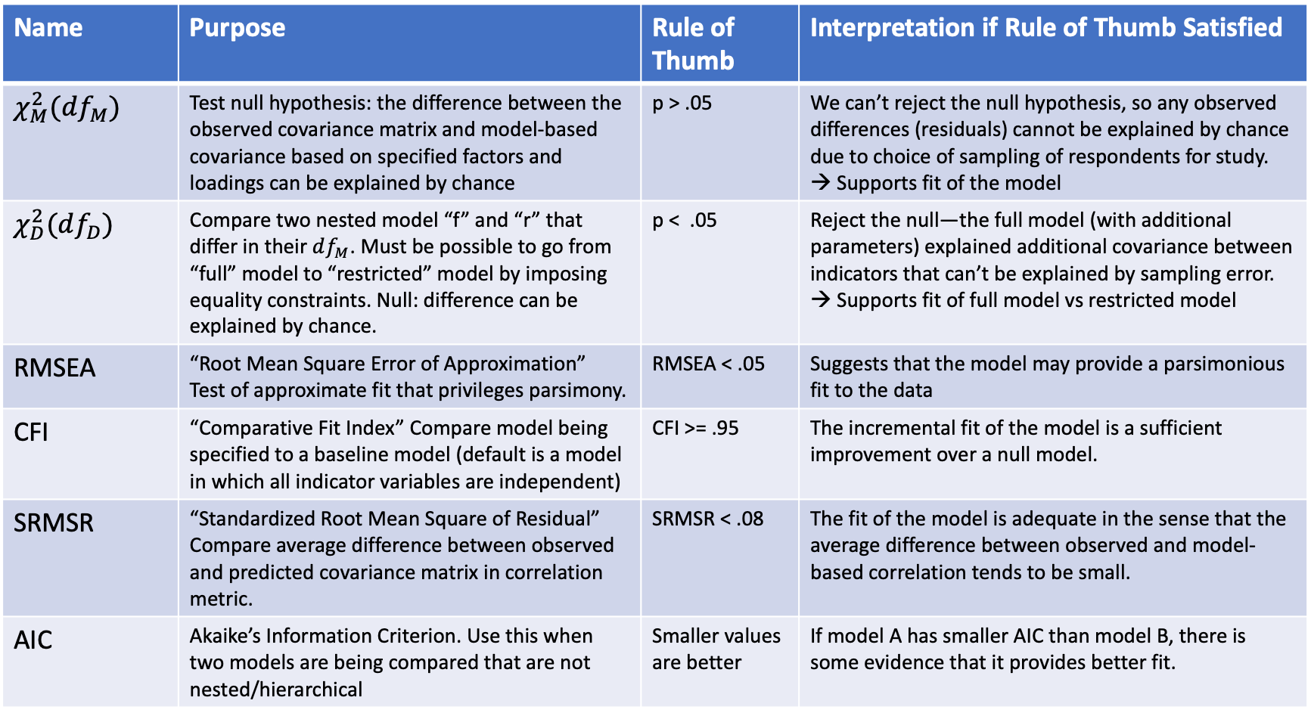
SEM Fit Statistic Crib Sheet
Name | Purpose | Rule of Thumb | Interpretation if Rule of Thumb Satisfied
$$χ_{M}^{2}(df_{M})$$ | Test null hypothesis: the difference between the observed covariance matrix and model-based covariance based on specified factors and loadings can be explained by chance | p > .05 | We can’t reject the null hypothesis, so any observed differences (residuals) cannot be explained by chance due to choice of sampling of respondents for study. → Supports fit of the model
$$χ_{D}^{2}(df_{D})$$ | Compare two nested model “f” and “r” that differ in their $df_{M}$. Must be possible to go from “full” model to “restricted” model by imposing equality constraints. Null: difference can be explained by chance. | p < .05 | Reject the null—the full model (with additional parameters) explained additional covariance between indicators that can’t be explained by sampling error. → Supports fit of full model vs restricted model
RMSEA | “Root Mean Square Error of Approximation” Test of approximate fit that privileges parsimony. | RMSEA < .05 | Suggests that the model may provide a parsimonious fit to the data
CFI | “Comparative Fit Index” Compare model being specified to a baseline model (default is a model in which all indicator variables are independent) | CFI >= .95 | The incremental fit of the model is a sufficient improvement over a null model.
SRMSR | “Standardized Root Mean Square of Residual” Compare average difference between observed and predicted covariance matrix in correlation metric. | SRMSR < .08 | The fit of the model is adequate in the sense that the average difference between observed and model-based correlation tends to be small.
AIC | Akaike’s Information Criterion. Use this when two models are being compared that are not nested/hierarchical | Smaller values are better | If model A has smaller AIC than model B, there is some evidence that it provides better fit.

Slide 19
In general, the fit statistics RMSEA, CFI, TLI and SRMSR from the SEM literature are not used to justify the fit of IRT Models
End of aside

Slide 20
Notice that the 3PL did not converge…
mod3 <- mirt(d, 1, itemtype= "3PL", SE = TRUE)
Iteration: 500, Log-Lik: -25320.410, Max-Change: 0.00023
EM cycles terminated after 500 iterations.
But it does actually converge if we increase max iterations to 2000
mod3<- mirt(cde, 1, itemtype=“3PL”, technical = list(NCYCLES = 2000))
Some advice from Chalmers in use of mirt to fit 3PL: “Unrestricted full-information factor analysis is known to have problems with convergence, and some items may need to be constrained or removed entirely to allow for an acceptable solution. As a general rule dichotomous items with means greater than .95, or items that are only .05 greater than the guessing parameter, should be considered for removal from the analysis or treated with prior distributions. Also, increasing the number of quadrature points per dimension may help to stabilize the estimation process.”
https://www.rdocumentation.org/packages/mirt/versions/0.2.6/topics/mirt

Slide 21
Item Fit

Slide 22
Comparing SEs of Item Parameter Estimates
 | Difficulty |  | Discrimination
 | 2PL | 3PL | 2PL | 3PL
Mean | .093 | .177 | .093 | .179
SD | .042 | .154 | .027 | .152

Slide 23
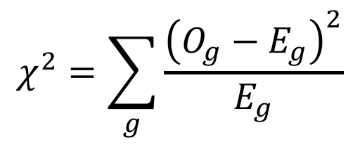
Chi-Square Test Statistics
Groups (g) | X=1 | X=0
1
2
3
4
5
6
7
8
9
10
$$χ^{2}=\sum_{g}{\frac{{\left(O_{g}−E_{g}\right)}^{2}}{E_{g}}}$$
Shape of distribution depends on degrees of freedom (df). Usually, given an m (row) by n (column) matrix, df = (m-1) x (n-1). So in this example df = (10-1) x (2-1) = 9.
In an IRT context “E_{g}” is expected number of correct responses, and is determined by the IRF of the item in question.

Slide 24
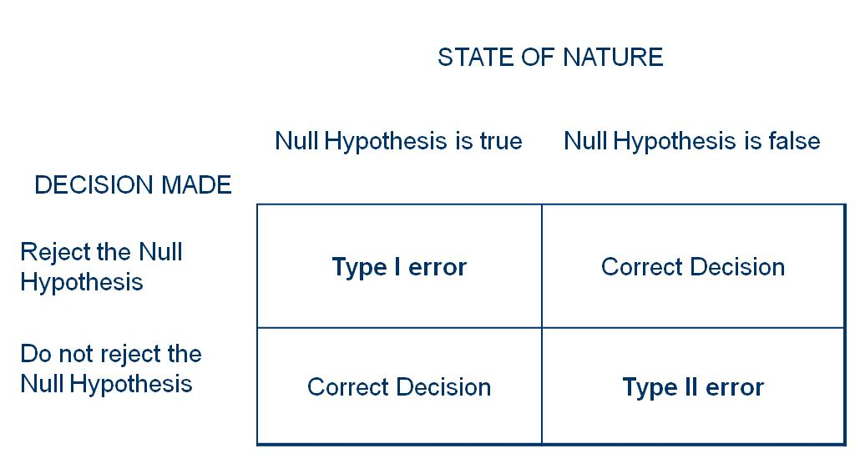
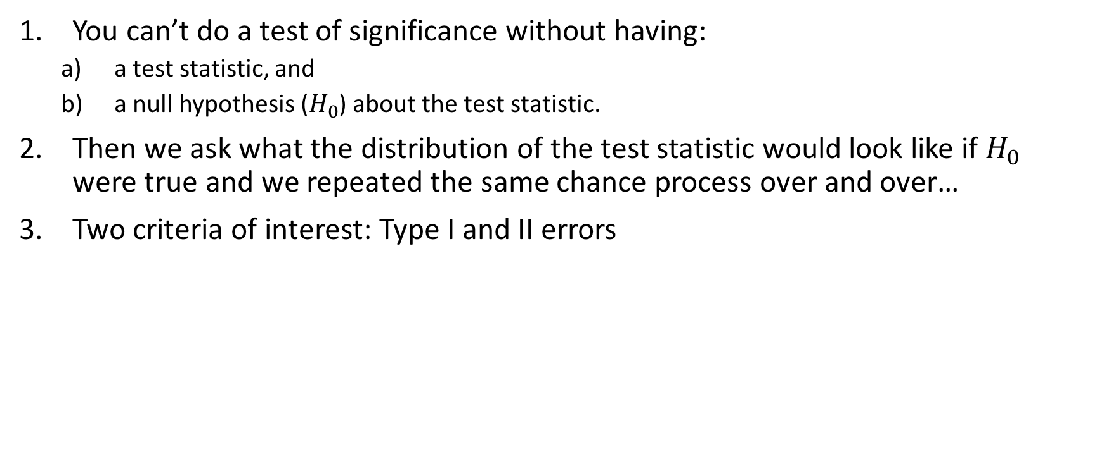
Quick Refresher on Significance Testing
You can’t do a test of significance without having:
a test statistic, and
a null hypothesis ($H_{0}$) about the test statistic.
Then we ask what the distribution of the test statistic would look like if $H_{0}$ were true and we repeated the same chance process over and over…
Two criteria of interest: Type I and II errors

Slide 25
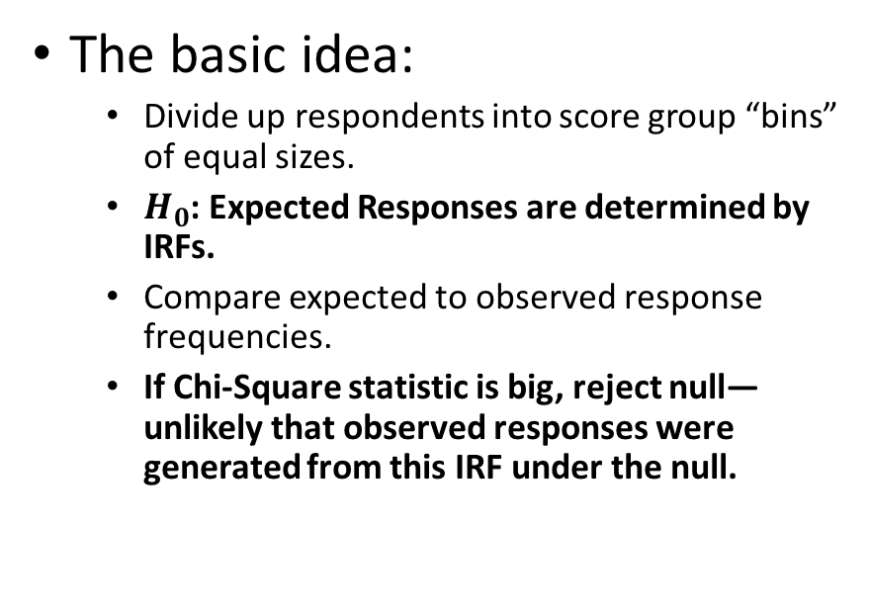
Significance Testing for Item Fit
Between Group Approach
Standardized Residual
The basic idea:
Divide up respondents into score group “bins” of equal sizes.
$H_{0}$: Expected Responses are determined by IRFs.
Compare expected to observed response frequencies.
If Chi-Square statistic is big, reject null—unlikely that observed responses were generated from this IRF under the null.
The basic idea
For each item by respondent (or respondent at same score level) combination, compare expected to observed.
Standardize these residuals such that they have normal distribution if model fits.
Basis for the “infit” and “outfit” Rasch model fit statistics.

Slide 26
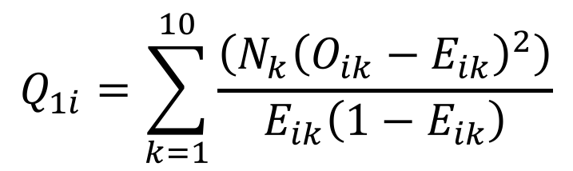
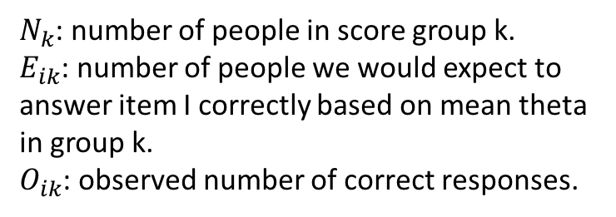
Yen’s “Q1” Item Fit Statistic
$N_{k}$: number of people in score group k.
$E_{ik}$: number of people we would expect to answer item I correctly based on mean theta in group k.
$O_{ik}$: observed number of correct responses.
$$Q_{1i}=\sum_{k=1}^{10}{\frac{\left(N_{k}{\left(O_{ik}−E_{ik}\right)}^{2}\right)}{E_{ik}\left(1−E_{ik}\right)}}$$
Known as a “Pearsonian” goodness-of-fit statistic
For each item break the estimated theta distribution into 10 equally sized groups. Take the mean of theta as average ability in each group and use to compute E.
Compare expected to observed frequency of responses in two categories (item correct, item incorrect).
Sum should have Chi-Square distribution with 10 – m degrees of freedom (where m = number of item parameters in IRF, usual 1, 2, or 3).
Notes: can use different number of groups or median instead of mean, but then it is not technically the “Q1” statistic; sometimes there are not enough observations in one of k categories, and one gets dropped.

Slide 27
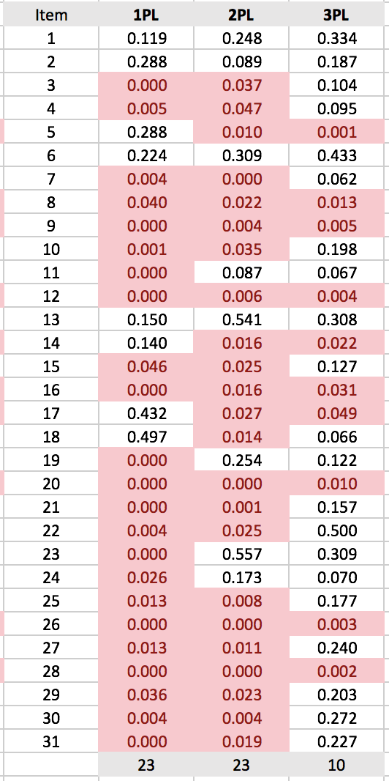
p-values from mirt()
itemfit(mod1, fit_stats=c("X2”), group.bins=10, method="EAP")
itemfit(mod2, fit_stats=c("X2"), group.bins=10, method="EAP”)
itemfit(mod3, fit_stats=c("X2"), group.bins=10, method="EAP")
Highlighted items are ones we would flag as potentially misfitting. Note that many misfit all three models! e.g. 12, 16, 20.
Low p-values suggest we can reject null that correct/incorrect responses could be explained by IRF.
Note: there are concerns about these statistics because they rely on estimated item and person parameters. Have been shown to result in very high Type I error rates! (Orlando & Thissen, 2000)
mirt package has many additional alternative indices. See ?itemfit and fit_stats

Slide 28
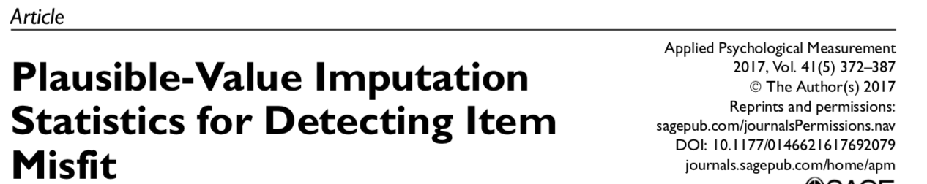
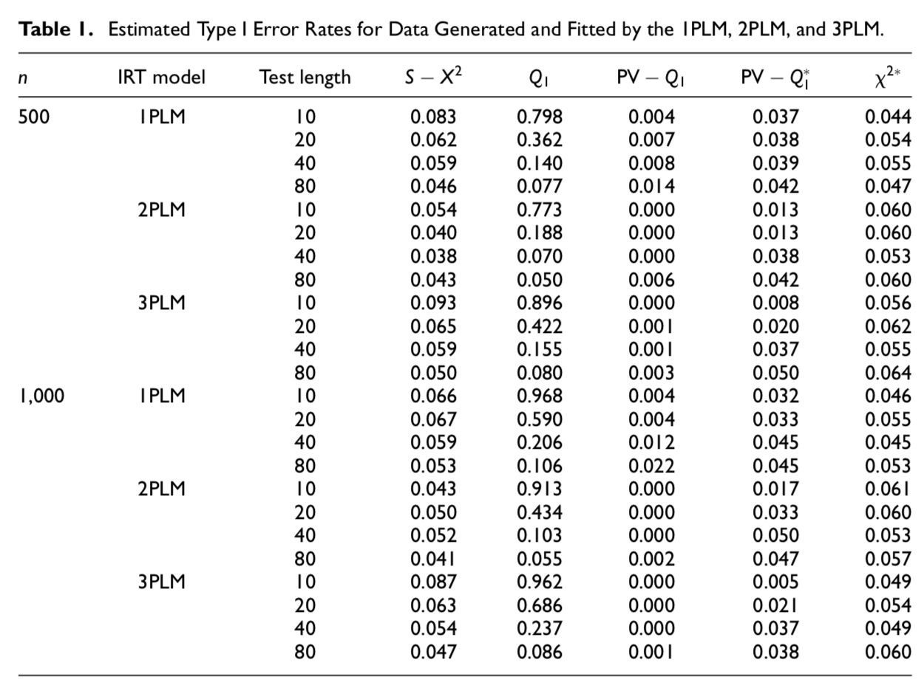
Chalmers & Ng (2017)
Bottom Line: Be very very careful about interpreting Q1 fit statistics, especially when you have fewer than 40 items.
Alternative to Yen’s Q1: Chalmer’s PV-Q1 and PV-Q1*
f2n<-itemfit(m2, fit_stats=c("X2","PV_Q1"), group.bins=10, method="EAP")

Slide 29
Comparing Q1 to Chalmers’ PV-Q1 for CDE data using 2PL Results
Model | 2PL | 2PL
Item | Q1 | PV_Q1
1 | 0.25 | 0.44
2 | 0.09 | 0.29
3 | 0.04 | 0.44
4 | 0.05 | 0.25
5 | 0.01 | 0.37
6 | 0.31 | 0.44
7 | 0.00 | 0.03
8 | 0.02 | 0.35
9 | 0.00 | 0.33
10 | 0.03 | 0.39
11 | 0.09 | 0.26
12 | 0.01 | 0.21
13 | 0.54 | 0.52
14 | 0.02 | 0.37
15 | 0.03 | 0.32
16 | 0.02 | 0.44
17 | 0.03 | 0.43
18 | 0.01 | 0.46
19 | 0.25 | 0.47
20 | 0.00 | 0.02
21 | 0.00 | 0.01
22 | 0.03 | 0.38
23 | 0.56 | 0.31
24 | 0.17 | 0.32
25 | 0.01 | 0.14
26 | 0.00 | 0.07
27 | 0.01 | 0.18
28 | 0.00 | 0.04
29 | 0.02 | 0.25
30 | 0.00 | 0.08
31 | 0.02 | 0.21
Total Flags | 23 | 5
We go from 23 items flagged for misfit to 5 items flagged!

Slide 30
Note on Statistical Fit from Yen & Fitzpatrick
“Thus, a compelling case can be made for treating statistical analyses of item fit as informative but not definitive. These statistics can provide a basis for identifying items on which further analyses are needed. The summary statistics should be supplemented by more detailed analyses so that the reasons for the misfit of an item can be better understood.” (Yen and Fitzpatrick, 2006, p. 141).

Slide 31
Graphical Analysis of Item Fit
Ideally, look at item content and think of substantive/theoretical explanations. For CDE data we don’t have the items. But can still look at item fit plots
1PL Fit Plot
2PL Fit Plot
3PL Fit Plot
itemfit(mod1, fit_stats=c("X2"), group.bins=10, empirical.plot=14, xlim=c(-2,2))

Slide 32
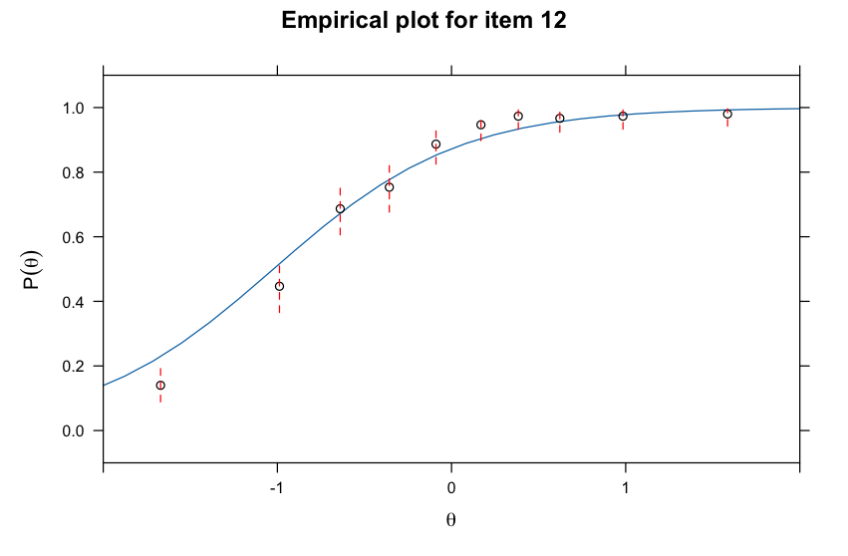
Only Item 12 shows evidence of misfit to 3PL when using PV-Q1

Slide 33
Infit and Outfit in Rasch model
Reminder: these are based on standardized residuals.
Used to evaluate fit of Rasch model.
Most informative about whether items conform to equal slopes assumption.
In mirt:
itemfit(mod1, fit_stats = "infit")

Slide 34
Person Fit

Slide 35
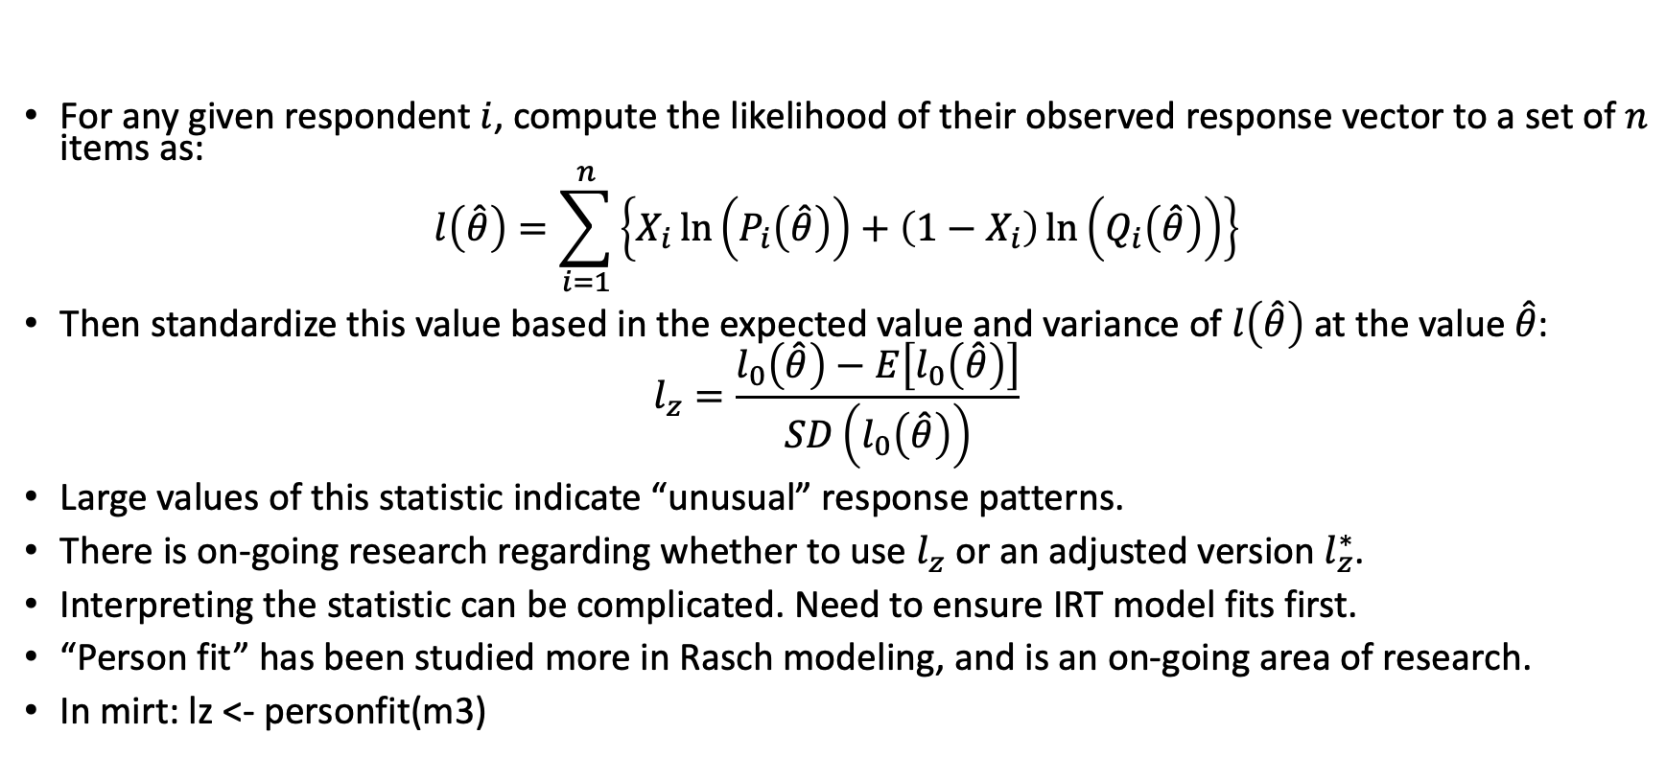

Person Fit with the $l_{z}$ Statistic
For any given respondent $i$, compute the likelihood of their observed response vector to a set of $n$ items as:
$$l\left(\hat{θ}\right)=\sum_{i=1}^{n}{\left\{X_{i}\ln\left(P_{i}\left(\hat{θ}\right)\right)+\left(1−X_{i}\right)\ln\left(Q_{i}\left(\hat{θ}\right)\right)\right\}}$$
Then standardize this value based in the expected value and variance of $l\left(\hat{θ}\right)$ at the value $\hat{θ}$:
$$l_{z}=\frac{l_{0}\left(\hat{θ}\right)−E\left[l_{0}\left(\hat{θ}\right)\right]}{SD\left(l_{0}\left(\hat{θ}\right)\right)}$$
Large values of this statistic indicate “unusual” response patterns.
There is on-going research regarding whether to use $l_{z}$ or an adjusted version $l_{z}^{∗}$.
Interpreting the statistic can be complicated. Need to ensure IRT model fits first.
“Person fit” has been studied more in Rasch modeling, and is an on-going area of research.
In mirt: lz <- personfit(m3)

Slide 36
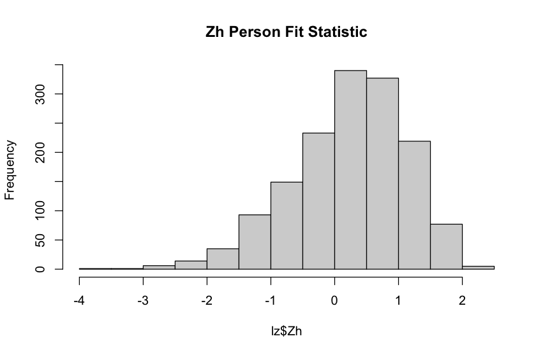
Distribution of lz for 3PL
Maybe these student weren’t giving consistent effort? Might check process data.

Slide 37
Local Independence

Slide 38
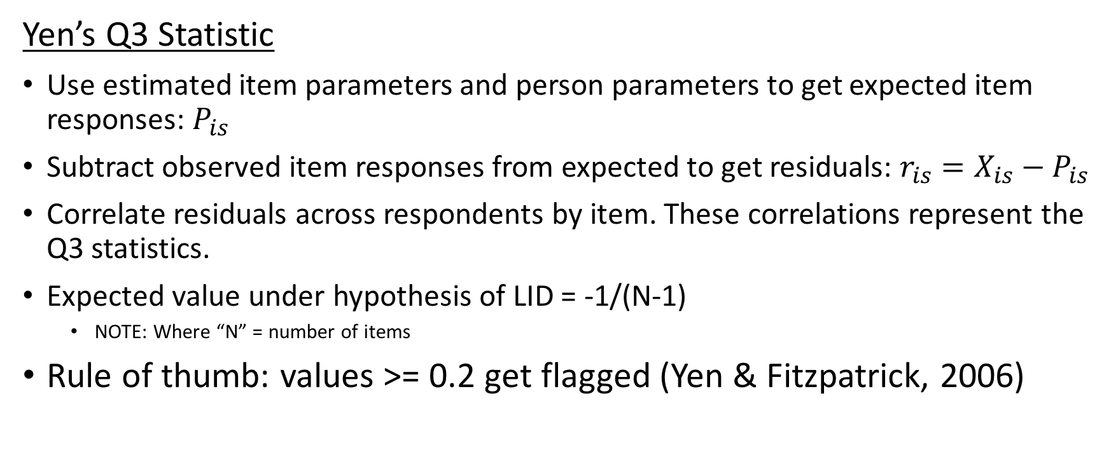
Local Independence Assumption
Yen’s Q3 Statistic
Use estimated item parameters and person parameters to get expected item responses: $P_{is}$
Subtract observed item responses from expected to get residuals: $r_{is}=X_{is}−P_{is}$
Correlate residuals across respondents by item. These correlations represent the Q3 statistics.
Expected value under hypothesis of LID = -1/(N-1)
NOTE: Where “N” = number of items
Rule of thumb: values >= 0.2 get flagged (Yen & Fitzpatrick, 2006)

Slide 39
Calculating Q3 Statistic in mirt()
residuals(mod3, type="Q3", method="EAP")
Again note that this will depend on both the specific IRT model being fit and how theta is estimated.
Here, we find no values greater than 0.2 in absolute value. Assumptions seems defensible.
summary(q3[lower.tri(q3)])
Min. 1st Qu. Median Mean 3rd Qu. Max.
-0.118702 -0.049555 -0.023562 -0.026432 -0.004529 0.083165

Slide 40
Parameter Invariance

Slide 41
Checking Parameter Invariance
Conceptual overview:
Split data into 2 random samples.
Fit IRT model in both samples.
Compare stability (“invariance”) of parameter estimates.
If invariance holds, parameters should be highly correlated.
In this dataset we don’t have any group variables (e.g., sociodemographic variables)
If we did, this would be a better check on parameter invariance—we’ll return to this in the context of DIF in a few weeks.

Slide 42
Parameter Invariance
# checking invariance
# I’ll assume the order in the data is random, so first half and second half of the data file are "random" samples
samp1 <- d[1:750,]
samp2 <- d[751:1500,]
est1 <- mirt(samp1, 1, itemtype = "3PL")
est2 <- mirt(samp2, 1, itemtype = "3PL")
coef1 <- coef(est1, IRTpars=TRUE, simplify = TRUE)$items
coef2 <- coef(est2, IRTpars=TRUE, simplify = TRUE)$items

Slide 43
3PL Parameter Invariance

Slide 44
3PL Parameter Invariance
More formal analysis would consider the standard errors of the parameter estimates.
This initial look suggests some stability of a and b parameters. But, the guessing parameters don’t seem very stable
The small sample sizes (750 per half) also warrant caution in interpretation.

Slide 45
Summary of Findings Re. Fit
There is evidence of a strong first factor, reasonable to assert that the data is “essentially” unidimensional
In a global sense, 3PL fits item response data better than 2PL, and 2PL fits better than 1PL.
The 3PL model converges after we remove item 23 or increase iterations
Item fit look pretty good under the 3PL; person fit seems ok too but might want to check students with values less than -2
Local independence seems to hold based on examination of residual correlations
Property of parameter invariance doesn’t hold for guessing parameters…may require either dropping items, setting prior values on guessing parameters, or fixing some of the values.

